Slide 1

Team 1

Slide 2
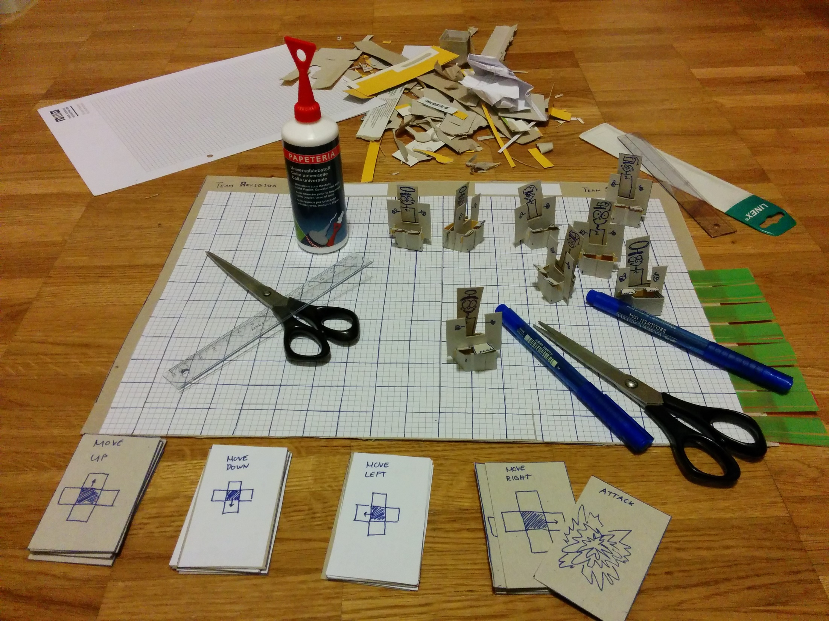
Notes:
Shooter
Boardgame

Slide 3
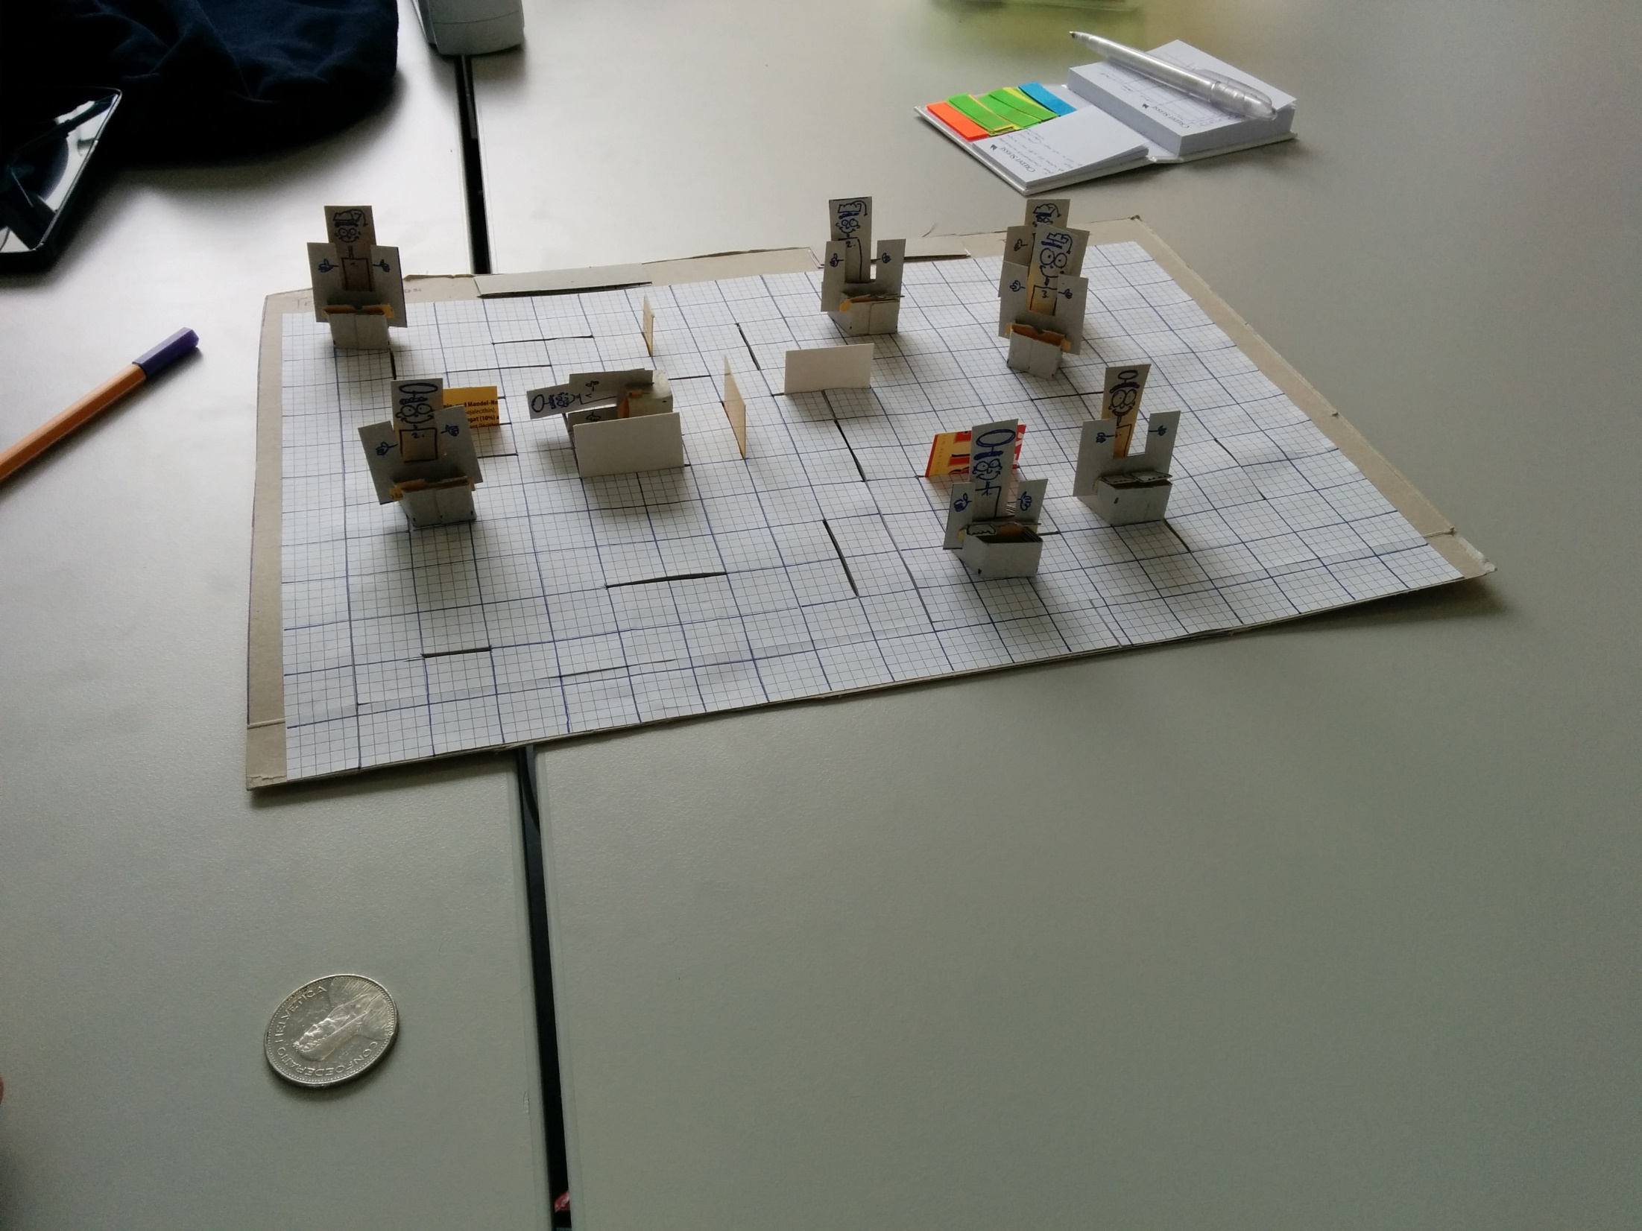
Notes:
Two Teams, Halo and University Hat
Obstacles, Modular Map
Cardboard walls

Slide 4
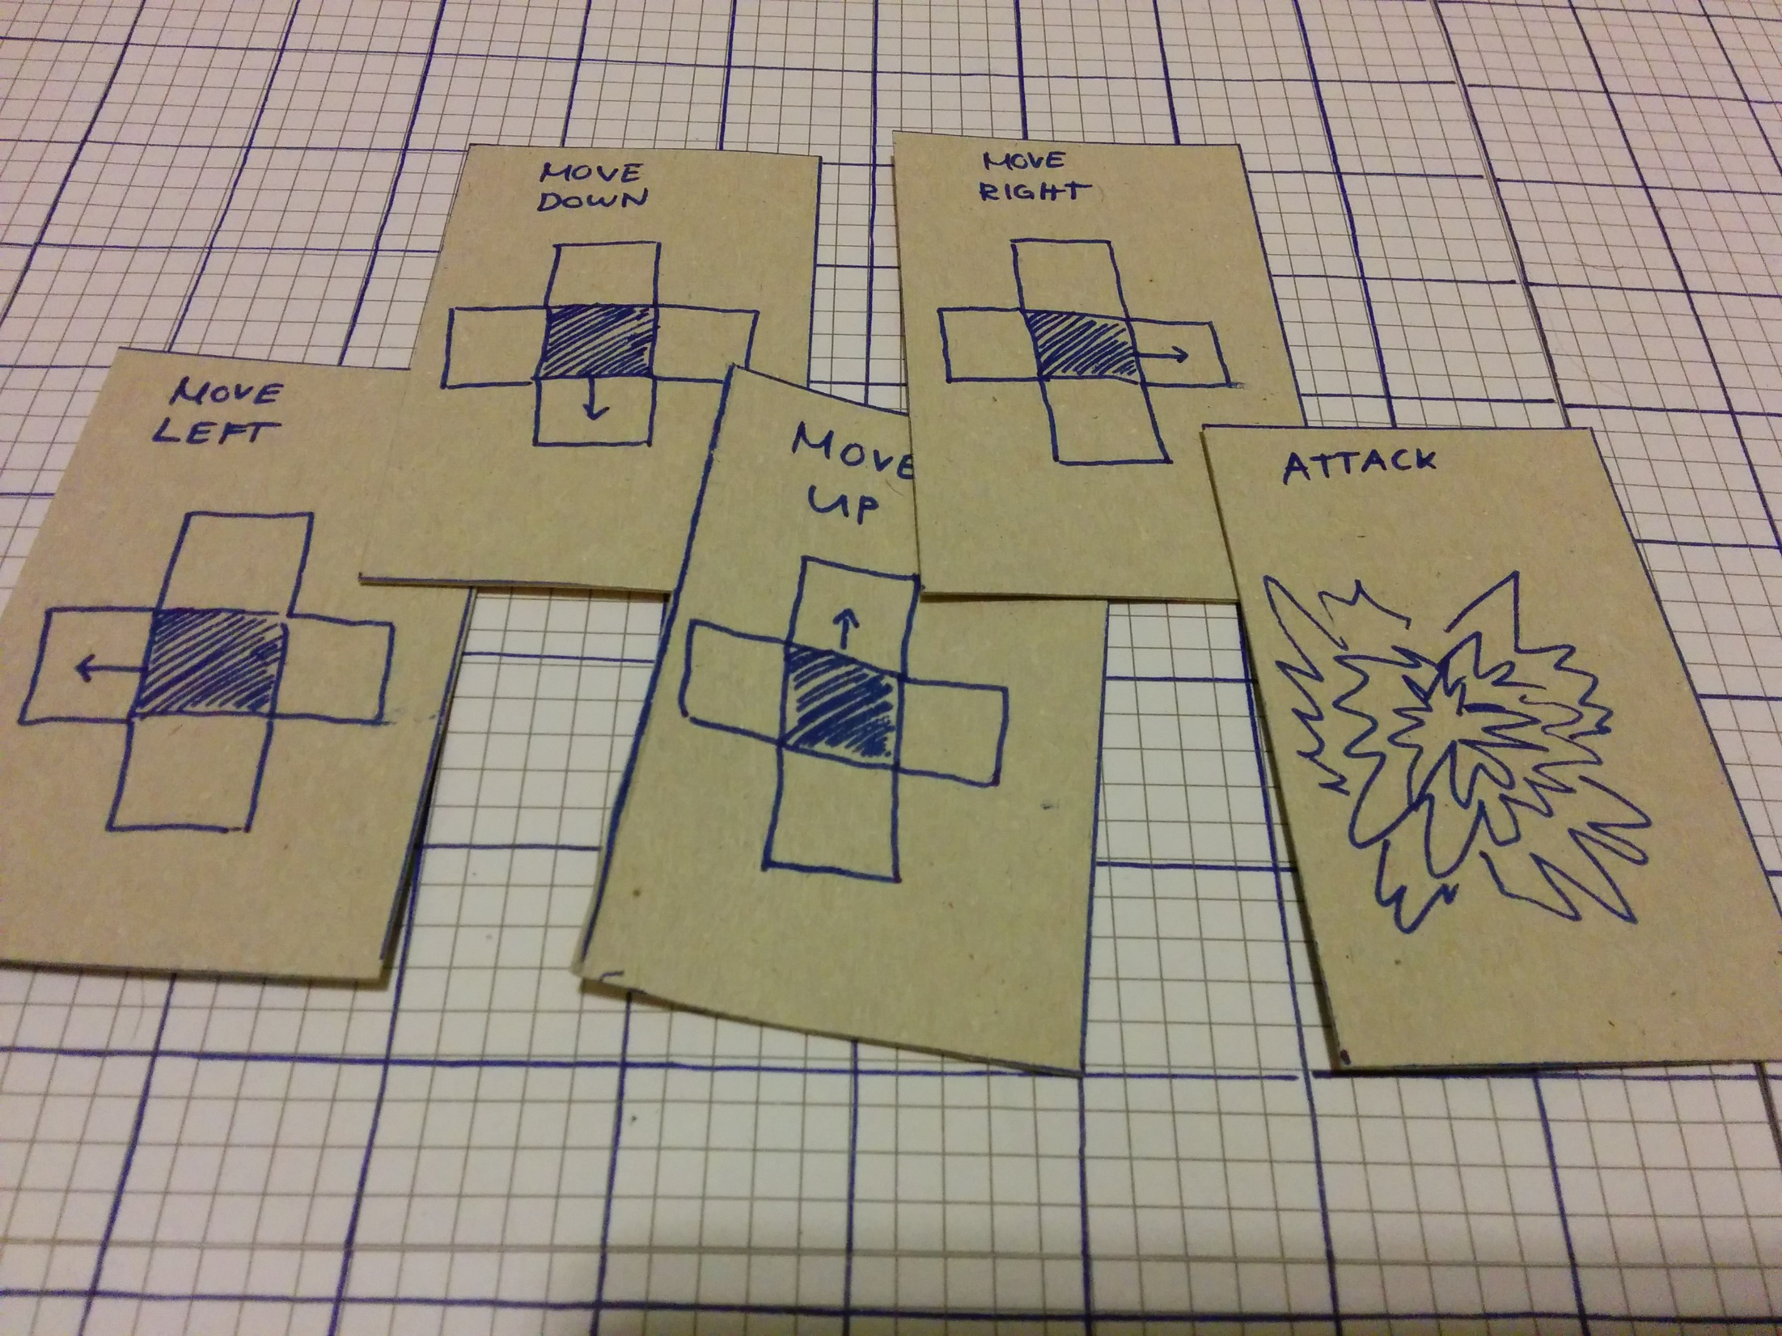
Notes:
Turn Based
Different cards
Pray/Study Card we introduced later (explained later)

Slide 5
Notes:
Shooting always has perfect aim
If two people shoot at the same time → Coin Flip
Person who gets shot flies away in the opposite direction & not able to move for 1 turn

Slide 6
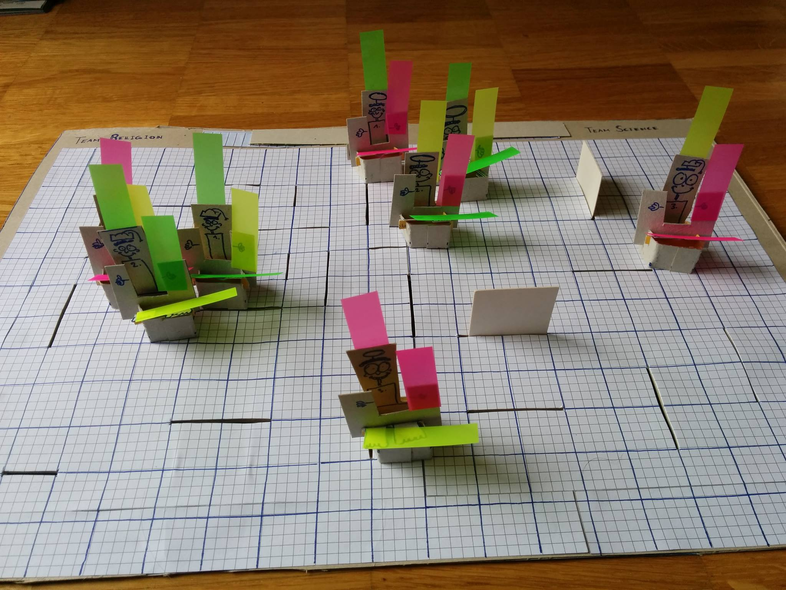
Notes:
Evolving players
Coloured stickers

Slide 7
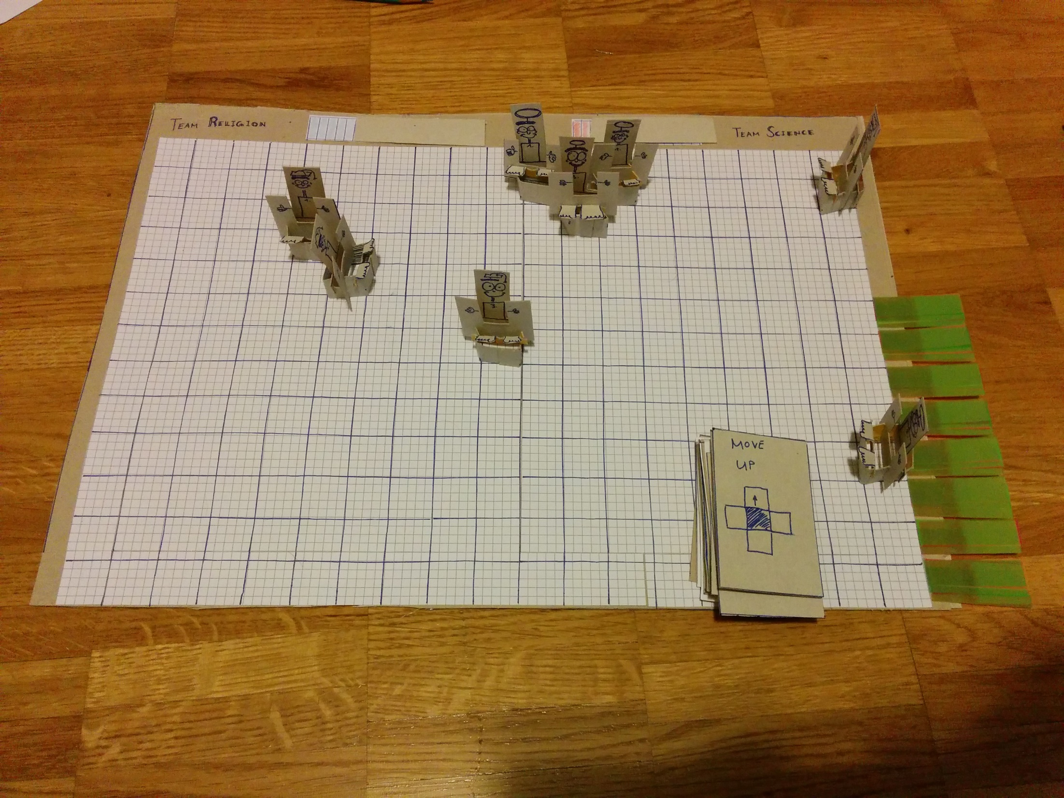
Notes:
Standing together to pray/study → Progress bar
Random Player possesses wonder
Instantly turned on
Gain speed boost

Slide 8
Findings & Feedback

Slide 9
(1/6) Map Design
Problem:
Corners, Dead ends
Solution:
No Corners/Dead Ends with obstacles
Continuous map

Slide 10
(2/6) Wonder Creation
Problem:
Easy Strategy: Pray & Protect, Study & Protect
Solution:
Commit to creation
Increased Vulnerability
Creation-Cooldown: Cooldown between creation and shooting

Slide 11
(3/6) Shoot impact
Problem:
Requirement to hit exactly: Difficult gameplay
Shooting infinite ray: Too easy to snipe over map
Solution:
Shotgun approach
= 100 % damage
= 0% damage

Slide 12
(4/6) Immunity-Cooldown after Hit-Cooldown
Problem:
Attacker can wait until target is on his feet to shoot again
Solution:
Immunity Cooldown

Slide 13
(5/6) Round Time
Problem:
It takes too long for all players to be converted
Solution:
Multiple time limited rounds
Winner team = team with most members

Slide 14
(6/6) Balancing
Problem:
Too many variables
Influence of being better running, shooting, wonder-creation
Speed of evolution
Solution:
Keep values small
Low Priority Evolution
Main aspect should be strategy
Creation-Cooldown

Slide 15
Thank you

